Slide 1
39 – Predictive Maintenance of Industrial Machinery
CAPSTONE PROJECT
Presented By:
AJAYKANNA K-KONGU ENGINEERING COLLEGE-MCA

Slide 2
OUTLINE
Problem Statement
Proposed System/Solution
System Development Approach
Algorithm & Deployment
Result
Conclusion
Future Scope
References

Slide 3
Problem Statement
Develop a predictive maintenance model for a fleet of industrial machines to anticipate failures before they occur. This project will involve analyzing sensor data from machinery to identify patterns that precede a failure. The goal is to create a classification model that can predict the type of failure (e.g., tool wear, heat dissipation, power failure) based on real-time operational data. This will enable proactive maintenance, reducing downtime and operational costs.

Slide 4
PROPOSED SOLUTION
The system predicts machine failures using sensor data. It enables proactive maintenance to reduce downtime.
Data Collection
Gather historical sensor data from industrial machines, including temperature, vibration, pressure, power consumption, and usage duration.
Collect real-time operational logs and failure event records, annotated with the type of failure (e.g., tool wear, heat dissipation, power failure).
Data Preprocessing
Clean and preprocess the data to handle missing values, noise, and anomalies in sensor readings.
Perform Feature Engineering by Rolling averages, spikes, trends, rate of change.

Slide 5
PROPOSED SOLUTION
Machine Learning Algorithm
Implement a classification model (e.g., Random Forest, XGBoost, or Neural Networks) to predict the type of failure.
Use multiclass classification to distinguish between different failure categories.
Deployment
Develop a real-time monitoring interface or dashboard to visualize machine health and alert maintenance teams.
Deploy the solution using IBM Cloud Lite for scalable and secure access.

Slide 6
PROPOSED SOLUTION
Evaluation
Assess the model's performance using appropriate metrics such as:
Accuracy
Precision
Recall
F1-Score, and Confusion Matrix
Result
SNAP-based Random Forest Classifier achieved 99.5% accuracy in failure prediction. Enhancements included HPO-1, Feature Engineering (FE), and HPO-2.

Slide 7
System Approach
System Requirements
IBM Cloud account with access to watsonx.ai Studio
Internet-enabled device (Laptop/Desktop)
Tools & Libraries
IBM watsonx.ai Studio – for model training and deployment
AutoAI / Notebook – for building and evaluating models
Hyperparameter optimization tools – GridSearchCV or AutoAI’s built-in HPO

Slide 8
Algorithm & Deployment
Algorithm Selection
A Random Forest Classifier was chosen for its accuracy and robustness in handling noisy sensor data. It effectively predicts failure types such as tool wear, heat issues, and power failure.
Data Input
Temperature, vibration, power consumption, pressure
Time since last maintenance
Machine operating hours, load, and failure history
Training Process
Feature Engineering (FE), Cross-validation, Hyperparameter Optimization (HPO-1 and HPO-2)

Slide 9
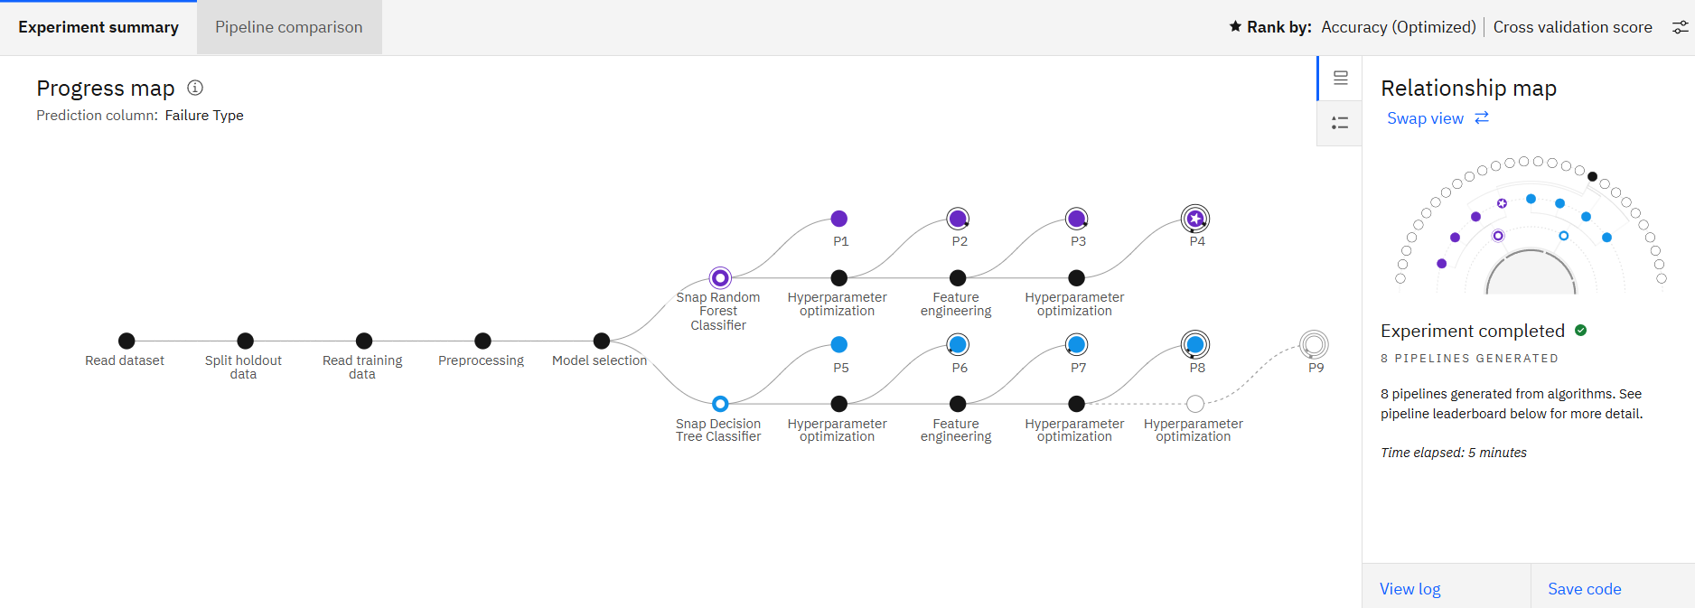
Result

Slide 10
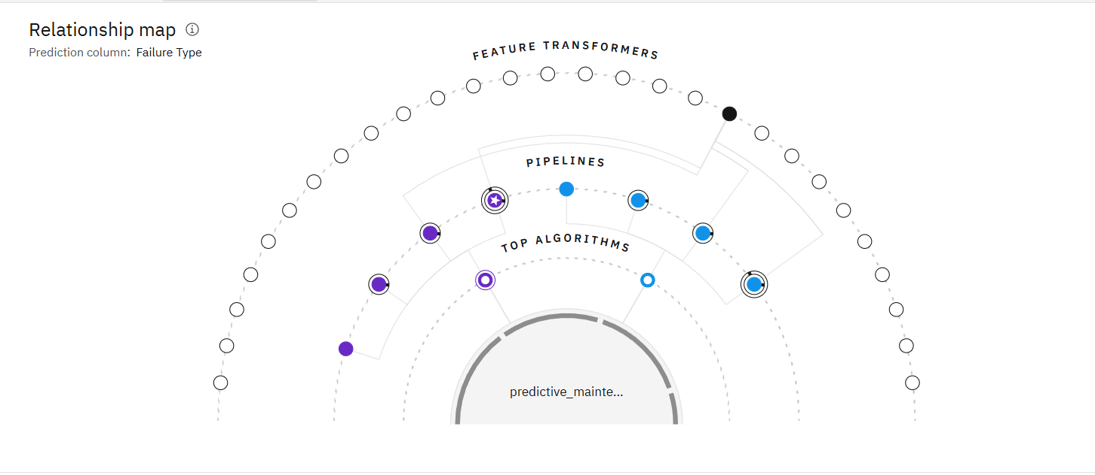
Result

Slide 11
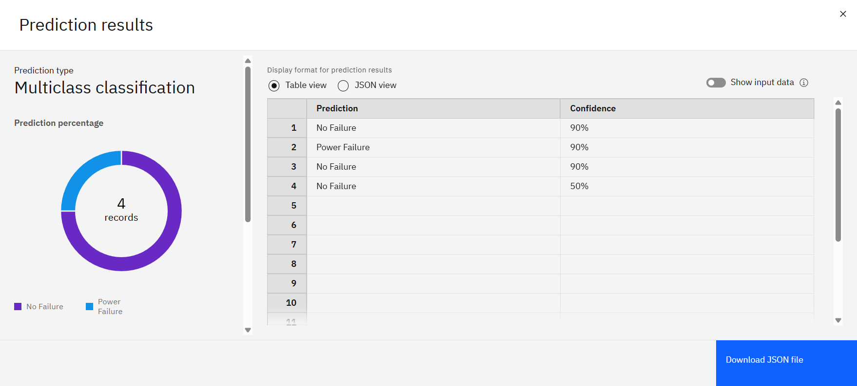
Result

Slide 12
Conclusion
The predictive maintenance model achieved 99.5% accuracy in detecting machine failures using sensor data. Challenges like noisy data and parameter tuning were overcome through feature engineering and optimization. Accurate failure prediction ensures reduced downtime and improved industrial efficiency.

Slide 13
Future scope
Future enhancements include integrating additional sensor data (e.g., humidity, machine age) and optimizing the model with advanced techniques like deep learning. The system can be scaled to monitor machines across multiple facilities or regions. Incorporating edge computing can enable real-time failure detection directly at the source.

Slide 14
References
https://www.ibm.com/blog/predictive-maintenance-machine-learning/
https://towardsdatascience.com/predictive-maintenance-using-machine-learning-38e7f72e37b7
https://scholar.google.com/scholar?q=predictive+maintenance+machine+learning+survey
DATASET
https://www.kaggle.com/datasets/shivamb/machine-predictive-maintenance-classification
ML TOOLS
https://www.ibm.com/products/watsonx-ai

Slide 15
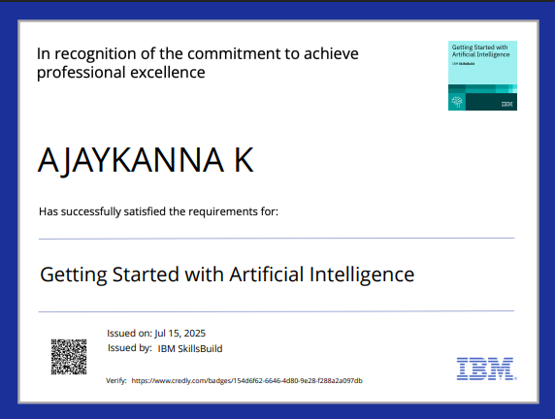
IBM Certifications

Slide 16
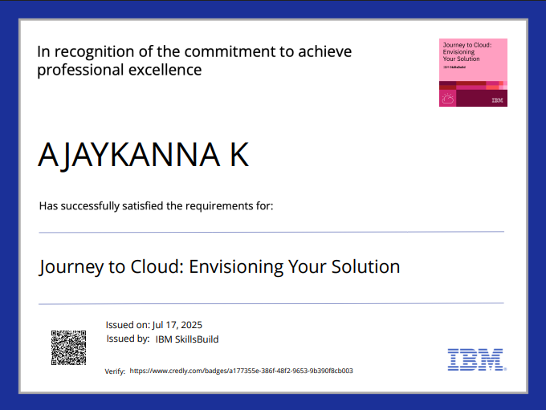
IBM Certifications

Slide 17
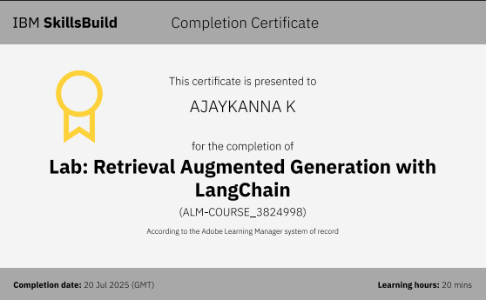
IBM Certifications

Slide 18
THANK YOU

